Slide 1



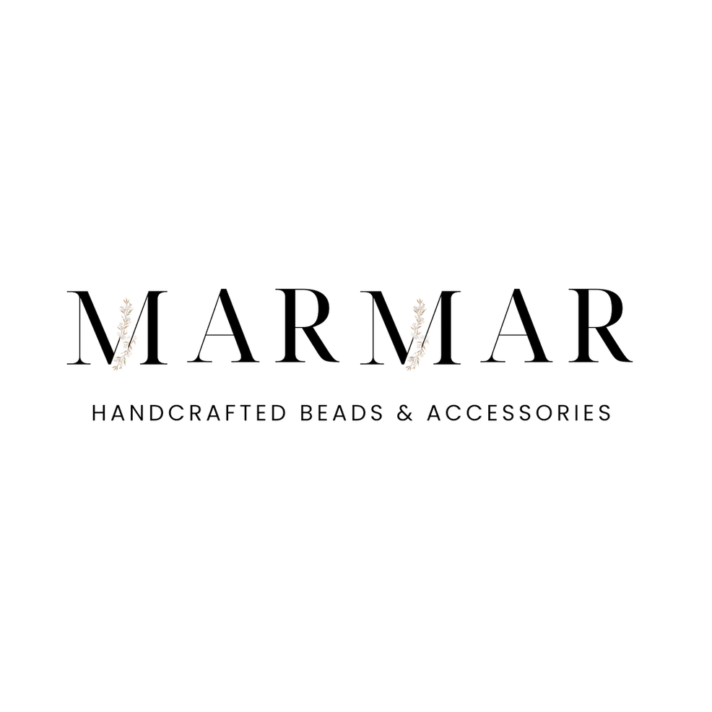
DIGITAL MARKETING SPECIALIST
GRADUATION PROJECT
PROJECT BY : GROUP 5

Slide 2

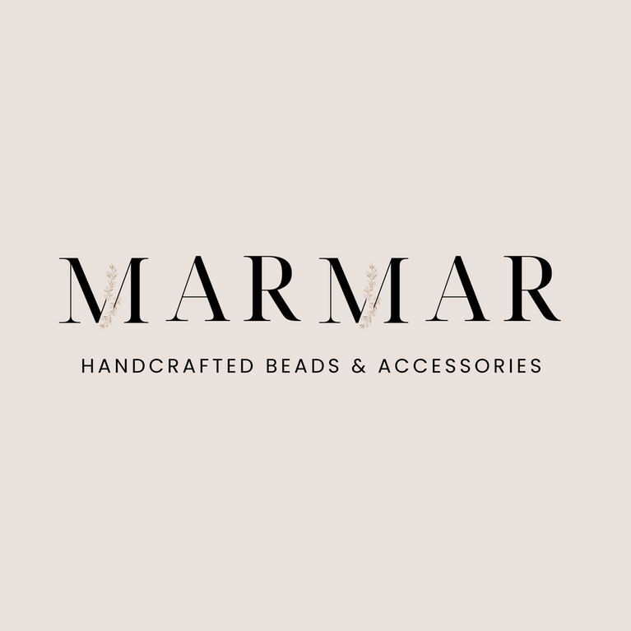
BRAND LOGO:
BRAND NAME:
MARMAR

Slide 3
ABOUT
Marmar is more than just a brand; it’s a story of passion, craftsmanship, and creativity. Founded by Amina, Marmar brings together the artistry of handmade fashion and the desire for self-expression. Each piece is carefully crafted by local artisans, making every accessory not only stylish but truly one-of-a-kind.
Our designs cater to women who value individuality, exclusivity, and ethical fashion. Whether it’s a custom-made bag or a limited-edition accessory, Marmar is about celebrating your unique style and giving you the confidence to stand out. With every purchase, you’re not only enhancing your wardrobe but supporting local artisans and sustainable practices, ensuring that fashion remains personal, ethical, and beautiful.

Slide 4
Vision
Mission
To inspire individuality and empower self-expression through unique, handcrafted accessories that celebrate personal style and creativity. Marmar aims to become a leading brand in the handmade fashion industry, fostering a deeper connection between artisans and customers while promoting sustainable, ethical practices in every design.
At Marmar, our mission is to create one-of-a-kind, personalized accessories that reflect the heart and soul of both our artisans and customers. By blending craftsmanship with innovation, we deliver exclusive, high-quality pieces that empower women to showcase their individuality confidently. We are committed to sustainability, supporting local artisans, and ensuring that each product we offer embodies care, creativity, and ethical fashion principles.

Slide 5
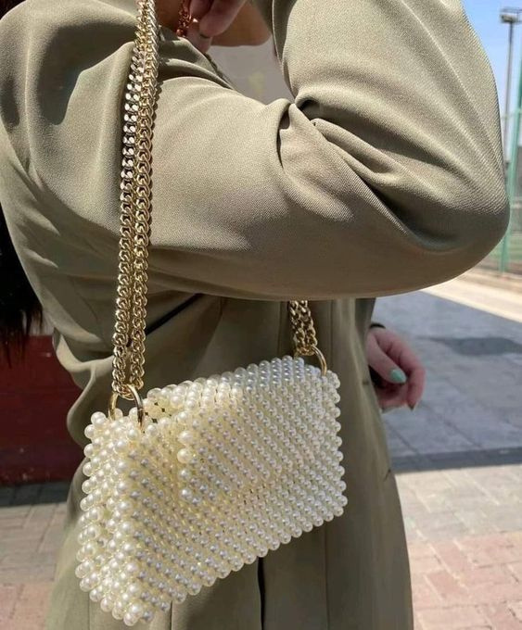
Market Analysis
Estimated Market Size of Handcrafts in local market is 8 Billion EGP
Total Exports of handcrafts is 250 $ M in 2023
INDUSTRY OVERVIEW
KEY TRENDS
E-commerce Expansion
The rise of online shopping allows local brands to reach broader audiences without the cost of physical stores.
Support for local artisans
There is a global movement to support local industries, enhancing the value of handmade goods
Affordability
Rising import costs and inflation push consumers toward local, cost-effective options.
Story behind the product
Every handmade piece carries a story, making it more appealing to buyers.

Slide 6








Business
Model Canvas
Key Partners
Key Activities
Value Propositions
Customer Relationship
Customer Segments
Shipping Company
Packaging Supplier
Influncers
buying materials
Crafting accessories
Marketing and Sales
CRM
Unique high Quality Accessories
Loyalty Programs
NPS and Feedback
Interactive Content
Females aged 18-30
personalized fashion Accessories
Couples aged 20-30
Social Validation
Location : Alexandria , Mansoura
Key Resources
Channel
Raw Materials
Equipments
Social Media Platforms
Time and Effort
Instagram
TikTok
Facebook
Bazaars
Cost Structure
Revenue Stream
Raw Materials
Equipments
Labor Costs
Partnerships
Direct Sales
Service Fees

Slide 7
SWOT ANALYSIS
Strengths
Weaknesses
Handmade, Personalized Products :
Unique and customizable accessories made with care by local artisans.
Strong User-Generated Content (UGC) :
Engaged customers actively promote the brand on social media, boosting organic reach and trust.
Proactive Customer Service :
Quick response system for resolving issues via QR codes ensures efficient communication and problem-solving.
Limited Geographic Focus :
Mainly focused on Dakahlia and Alexandria.
Limited Resources :
Limited budget and production capacity.
Inconsistent Engagement :
Lack of strong CTAs and interactive content on social media.
Low quantity photos :
product pictures is low quality.
Threats
Opportunities
Competition :
New and larger brands offering similar products.
Social Media Reliance :
Changes in platform algorithms could limit visibility.
Economic Downturn :
Reduced consumer spending could affect luxury purchases.
Expand to New Cities :
Enter larger markets in Egypt.
Influencer Marketing:
Leverage influencers to boost reach..

Slide 8
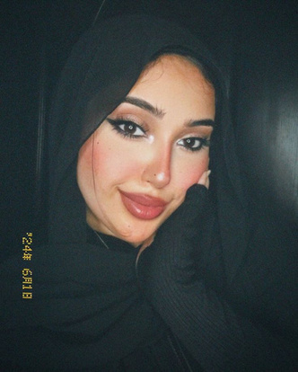
BUYER PERSONA 1 :
Goals and Aspiration :
Name: Esraa
Age: 18-23 years old
Gender: female
Income: Upper Middle-class
Education: High school graduates and college students .
Marital Status : single
To express their individuality through unique fashion items
Stay on-trend while supporting small businesses and artisans
Own accessories that are not mass-produced, reflecting exclusivity
Geographic location :
Gain Points :
GOVERNMENT : DAKAHLIA , ALEXANDRIA
Cities : Mansoura , Aga , Talkha , Mit Ghamr,
Dikirnis , El Senbellawein and Alexandria
Personalized Products
Supporting Local Artisan
Social Validation
Psychographics :
Shopping Habits and Preferences :
VALUES : INDIVIDUALITY AND SELF-EXPRESSION
INTERESTS : UNIQUE FASHION CHOICES , ARTS.
Preferences: handmade, artisanal products for their uniqueness .
Believes in supporting small businesses and artisans .
Prefers online shopping on Instagram, WhatsApp, or local e-commerce sites .
Interested in limited-edition pieces and discounts
.
Makes quick purchase decisions when an item feels unique and exclusive .

Slide 9
Value Proposition for Buyer Persona 1 :
Marmar offers unique, personalized fashion accessories that reflect your style and taste than mass-produced fashion brands offering generic, non-personalized accessories. It is for young, upper-middle-class women seeking unique fashion items. The products are handmade and have personalized designs to ensure that the bag is one of a kind. Also it gives you a social validation through sharing unique fashion items on social media and gaining recognition.

Slide 10
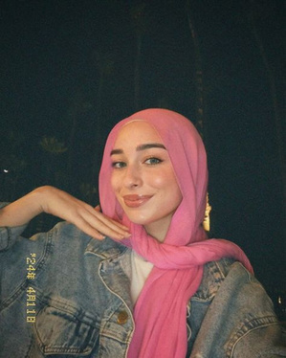
BUYER PERSONA 2 :
Goals and Aspiration :
Name: Shahd
Age: 20 – 30 years old
Gender: female
Income: Upper Middle-class B+
( 20000 to 50000 EGP per month )
Education: University graduate
Marital Status : Engaged
Aspire for professional success while maintaining personal well-being and style
Prefers to stand out with unique, high-end accessories that reflect her personal values
Stay on-trend while supporting small businesses and artisans
Wants to be seen as fashionable and confident with accessories reflecting exclusivity and stylish .
Geographic Location :
Gain Points :
Personalized Products
Supporting Local Artisan
Social Validation
Versatile Accessories
GOVERNMENT : DAKAHLIA , ALEXANDRIA
Cities : Mansoura , Aga , Talkha , Mit Ghamr,
Dikirnis , El Senbellawein and Alexandria
Psychographics :
Shopping Habits and Preferences :
VALUES : INDIVIDUALITY AND SELF-EXPRESSION , TIMELESSNESS AND VERSATILITY , PROFESSIONALISM AND CONFIDENCE
INTERESTS : FASHION , STYLE, ARTS , TRAVEL & CULTURE AND PERSONAL DEVELOPMENT .
Preferences: handmade, artisanal products for their uniqueness , Believes in supporting small businesses and artisans .
Shops both online (Instagram, WhatsApp and local e-commerce platforms) and in physical stores .
Prefers limited-edition or exclusive pieces that offer prestige
Values quality over quantity and is willing to pay for durable, well-crafted accessories

Slide 11
Value Proposition for Buyer Persona 2 :
Marmar offers high quality, personalized fashion accessories that reflect individuality and style than other mass produced fashion brands offering generic, High-quality accessories. It is for young professional women seeking unique, high-end accessories that align with your personal values and image. The personalized designs and attention to detail in the products ensures that the bag is a unique and valuable piece. Also it enhances your confidence and social validation through owning and sharing unique fashion items.

Slide 12

CUSTOMER JOURNEY
Stages
Touchpoints
Strategy
Customer Goals
Search
Instagram ads, influencers' posts, organic social media content, word of mouth
Use targeted Instagram ads showcasing unique products and leverage influencer partnerships to increase visibility
Discover unique, handmade fashion items
Evaluation
Product pages, social media engagement,UGC, reviews and testmonials
Create detailed product pages with stories behind the items, high-quality visuals, and customer testimonials to enhance trust
Assess product authenticity and craftsmanship
Share engaging video content demonstrating product features and customer reviews, encouraging social sharing
Test
Videos and posts showcasing product details, customer reviews
Experience the product's uniqueness before purchasing
Brand site, Instagram DMs, local e-commerce platforms, WhatsApp
Simplify the checkout process on the website; ensure multiple payment options are available and highlight first-time discounts
Purchase
Complete a smooth, secure purchase with ease
Follow-up emails, social media engagement, loyalty programs, customer surveys, WhatsApp
Implement a loyalty program with exclusive offers, personalized follow-ups, and regular engagement on social media to foster community
Retention
Stay connected with the brand and feel valued

Slide 13
Brand Mantra
Each piece contains a part of my heart
Brand Positioning Statement
To
Young women aged 18-30 in Dakahlia and Alexandria who value individuality, and exclusivity, and crave recognition on social media for their unique fashion choices.
Marmar is the
A handmade accessories brand.
That
Provides one of a kind, fashion forward accessories that make you feel special and outstanding publicly on social media, helping you gain recognition and admiration from peers and influencers.
That’s because
Our unique, handcrafted designs ensure you're wearing something exclusive, making your style pop in every post.
Marmar’s limited edition pieces are perfect for sharing on social platforms, where your distinct fashion sense can be celebrated by your social circle and beyond.

Slide 14

TONE OF VOICE
Tone of voice | DO | Don’t
Warm and Friendly | Use conversational language that feels approachable. | Avoid formal or stiff language that feels distant.
Authentic and Passionate | Share the stories behind your products and artisans | Don’t exaggerate or misrepresent the craftsmanship.
Inspirational and Empowering | Encourage self-expression and uniqueness | Don’t undermine your audience’s individuality.
Trendy and Youthful | Incorporate playful language and contemporary references. | Avoid outdated slang or overly complex terms.

Slide 15
Brand story(Hero's journey)
كان يا ما كان، كان في بنت صغيرة اسمها أمينة، حياتها كانت عادية زي أي بنت. بتلعب بالعرايس وبتعيش أيامها بشكل طبيعي. لكن كان عندها حاجة مميزة... من وهي عندها خمس سنين، كانت بتحب الإبرة والخيط، ومش مجرد حب عادي، دا كان حب كبير اوي .
في يوم، مامتها شافتها وهي بتخيط هدوم للعرايس بتاعتها، ومن هنا بدأت تلاحظ إن بنتها عندها موهبة مش عادية. كان الموضوع أكتر من مجرد لعبة، كان بداية نداء لمغامرة جديدة في عالم الإكسسوارات والهاند ميد .
في الأول، أمينة مكنتش متأكدة هي هتعمل إيه بالموهبه دي. كانت بتستمتع وهي بتعمل حاجات بسيطة بخيط وخرز من المكتبة بتاعت عمها، بس مكنتش عارفة إزاي تحول ده لحاجة أكبر.
هنا بتيجي بنت خالتها يسر في الصورة. يسر كانت قريبة من أمينة جداً، وخالتها كانت مدرسة اقتصاد منزلي ، وبتعلمها النسيج والخيوط. يسر وأمينة كانوا دايماً بيتعلموا مع بعض، كل واحدة كانت بتكتشف حاجة جديدة وبتشاركها مع التانية. كانوا بيساعدوا بعض في كل خطوة، وده كان بيخليهم يطوروا مهاراتهم وإبداعهم كل يوم في عالم الهاند ميد.
بعد ما أمينة اتعلمت كتير هي و يسر، قررت تاخد خطوة جديدة. قررت إنها تبدأ فعلاً تعمل تصميمات مميزة بإيديها، مش بس لنفسها، لكن كمان لحاجات ممكن تفرح بيها الناس. هنا، بدأت رحلة أمينة الحقيقية في عالم الهاند ميد .
أمينة ويسر بدأوا يعملوا مع بعض مشاريع صغيرة. كانوا بيتعلموا مع بعض وبيعدوا تحديات كتير. كل غرزة وكل تصميم كان بيحكي حكاية. قابلوا صعوبات كتير، من اختيار الخامات لحد تعلم أساليب جديدة. بس كل تحدي كان بيخليهم أقوى.

Slide 16
Brand story(Hero's journey)
وفي يوم، جت لحظة التحدي الكبير. أمينة ويسر قرروا يحولوا الشغف ده لبيزنس حقيقي. دي كانت اللحظة اللي فيها قرروا يبدأوا البراند بتاعهم . التحدي كان في إنهم يقنعوا الناس إن كل قطعة بيعملوها مميزة فعلا وفيها جزء من روحهم.
أول مرة يبيعوا منتجاتهم، كانت تجربة مليانة خوف وشك. هل الناس هتقدر تعبهم وحبهم للهاند ميد ؟ هل الناس هتشوف الجمال اللي هما شايفينه؟ كانت لحظة اختبار حقيقية ليهم.
بس النتيجة كانت مبهرة ! الناس حبوا منتجاتهم ، وبدأوا يشتروا ويطلبوا أكتر. كل حد اشترى حاجة من "مرمر" كان بيحس إنه مش مجرد بيشتري إكسسوار، لكن بيشتري جزء من حكاية أمينة ويسر.
دلوقتي، أمينة ويسر رجعوا للعالم بتاعهم القديم، لكن مع فرق كبير. هما دلوقتي أصحاب براند ناجح ، وبيبيعوا حاجات فيها جزء منهم وشغفهم بالهاند ميد .
مع كل قطعة بيبيعوها، بيحسوا إنهم بيحققوا حلمهم . شافوا إزاي حلمهم من وهم صغيرين بقى حقيقة. كل تصميم، كل خرزة، بتحكي قصة جديدة. رحلة طويلة بدأت من الطفولة وحلم صغير بقى براند كبير .
ودلوقتي، براند "مرمر" مش مجرد إكسسوارات هاندميد. دي قصة حلم اتحول لحقيقة . وكل حد يشتري منهم بيبقى جزء من الحكاية دي. شعارهم بيقول: "Each piece contains a prt of my heart“ ، وفعلاً دا مش مجرد شعار، دا حقيقة بنعيشها مع كل عميل جديد.
ومن هنا بتبدأ الحكاية من جديد مع كل حد يختار "مرمر".

Slide 17
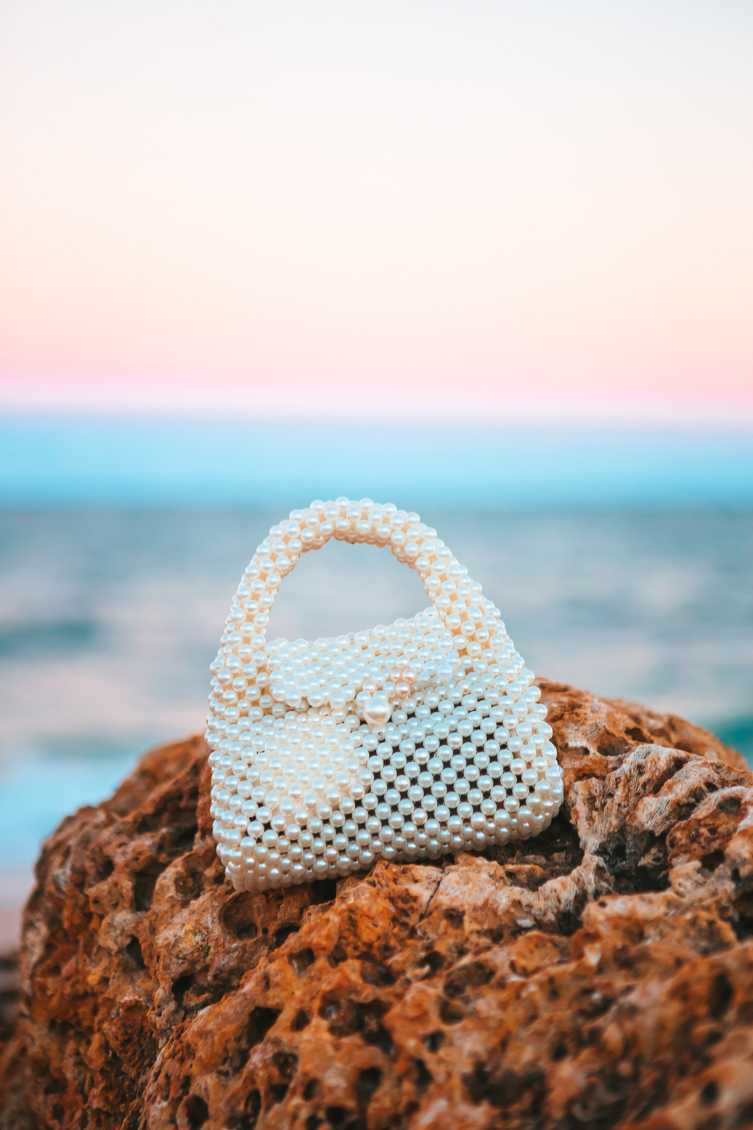
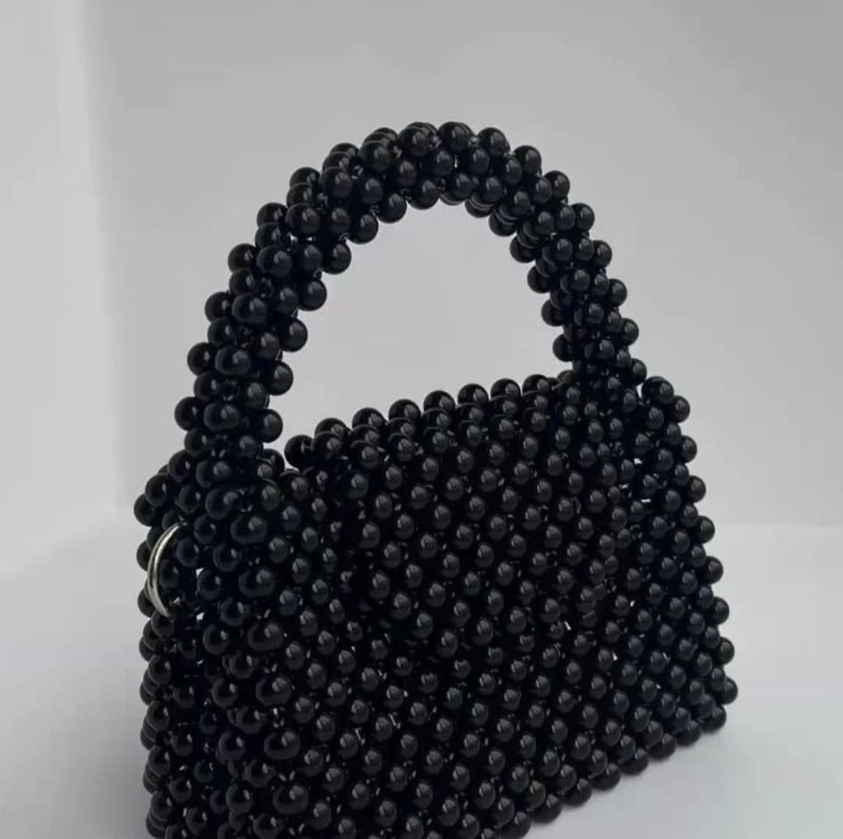
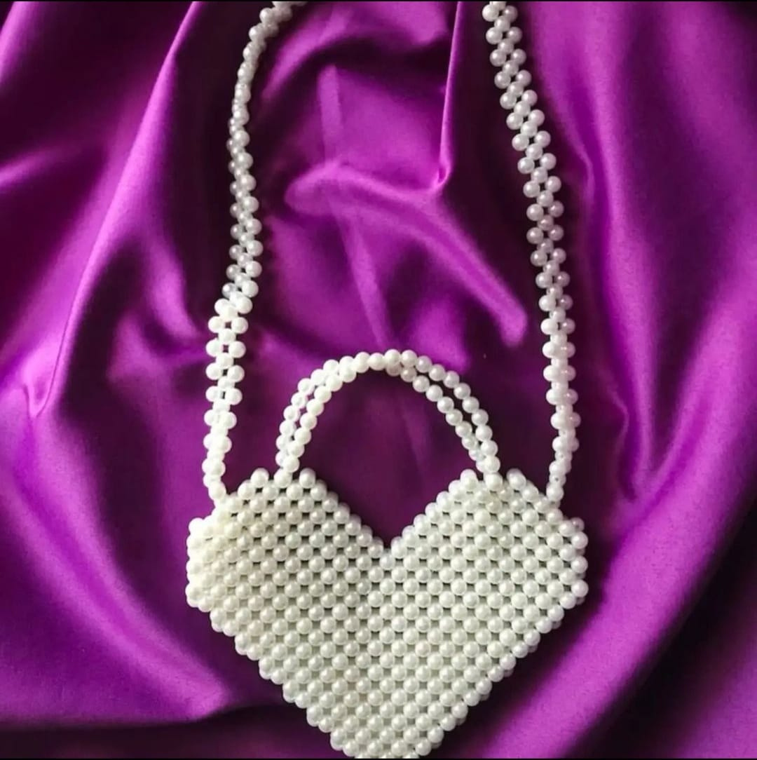
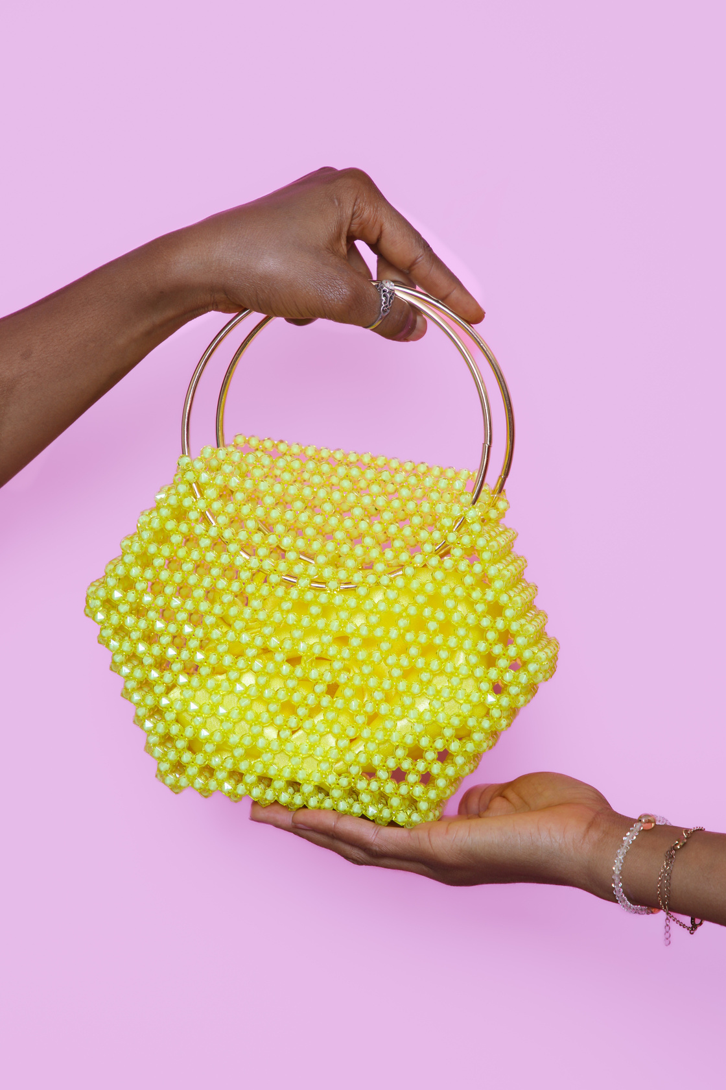


OUR PRODUCTS

Slide 18

Features & Benefits
Handcrafted Quality
Unique Expression
Limited Editions
Social Recognition
Customization
Exclusivity
Fashion-Forward
Customizable Trends

Slide 19
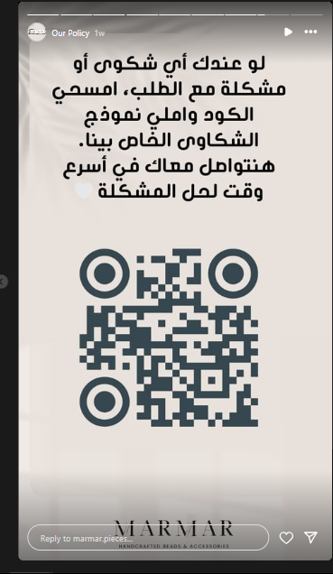
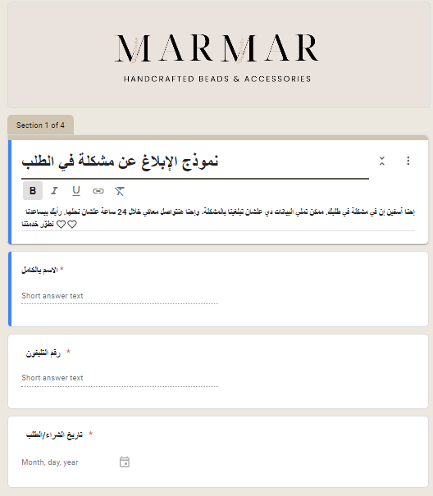
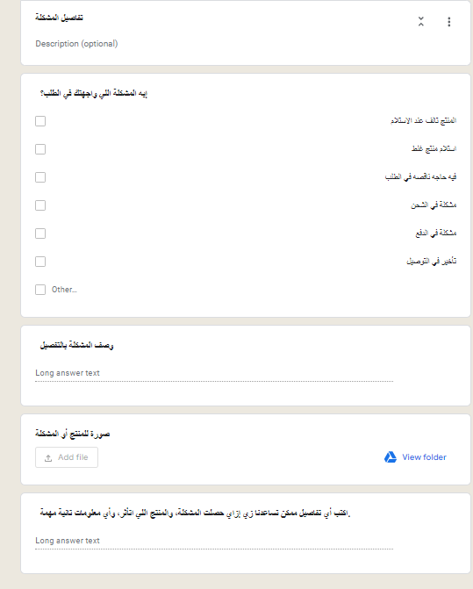
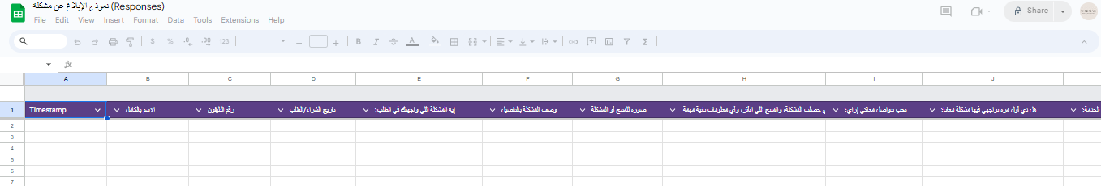

Slide 20


TOP KEYWORDS
keywords | monthly searches | Change over three months | Change compared to previous year
شنط هاند ميد | 10k-1k | 0% | 0%
شنط لولي هاند ميد | 10k-1k | 0% | +900%
خرز اكسسوارات | 10k-1k | 0% | 0%

Slide 21

CONTENT CALENDAR
(INSTGRAM)
DAY | Customer Journey Stage | Content Type | Topic/Description
Saturday | search | Product Showcase | High-quality photo showcasing the craftsmanship of a new product. Goal: Build awareness and showcase uniqueness.
Tuesday | Test | User‐Generated | Repost a happy customer's photo with their review
Thursday | Evalute | FAQ Carousel | Answer top 5 FAQs about beaded bags (durability, care, etc.).

Slide 22
MARKETING STRATEGY
Nr.1
Nr.2
Nr.3
Social Media
Influencer Marketing
Content Marketing
Build up a social media presence and raise awareness to build up organic reach and upload regularly to reach more people
Collaborate with influencers that affect our targeted persona to increase reach and potential customers
Upload content showcasing our product it’s benefits and competitive advantage

Slide 23
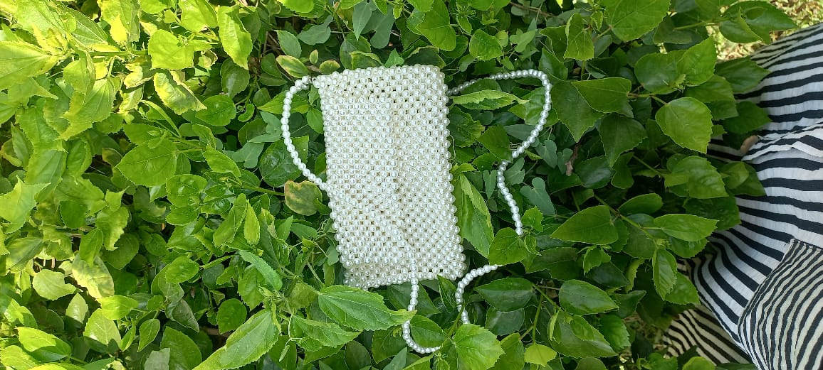
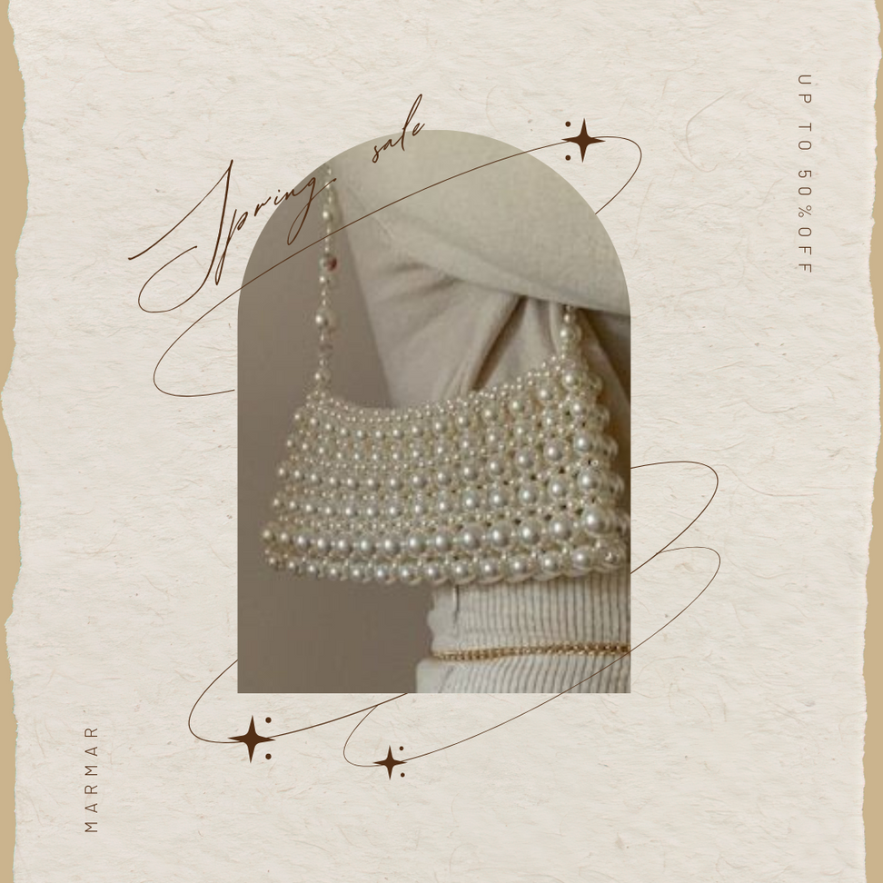
CONTENT

Slide 24
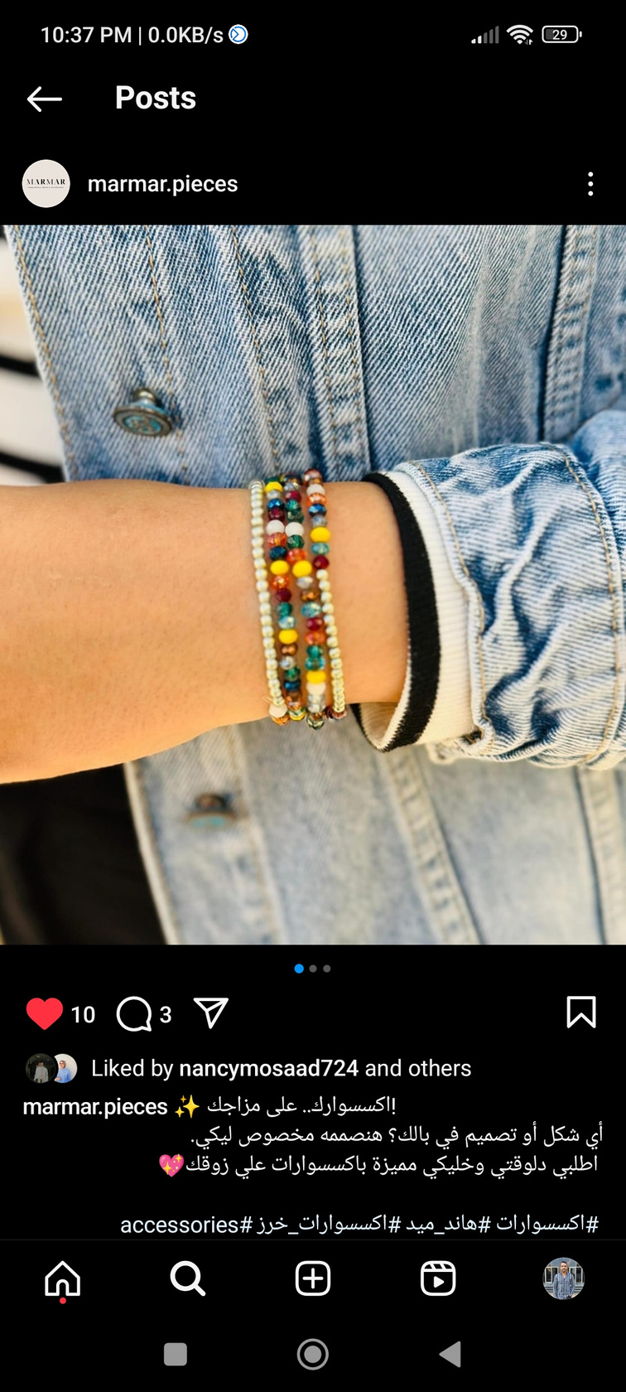
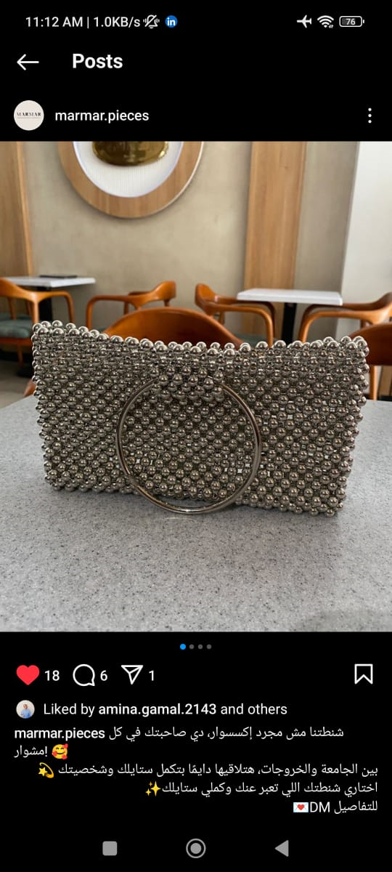
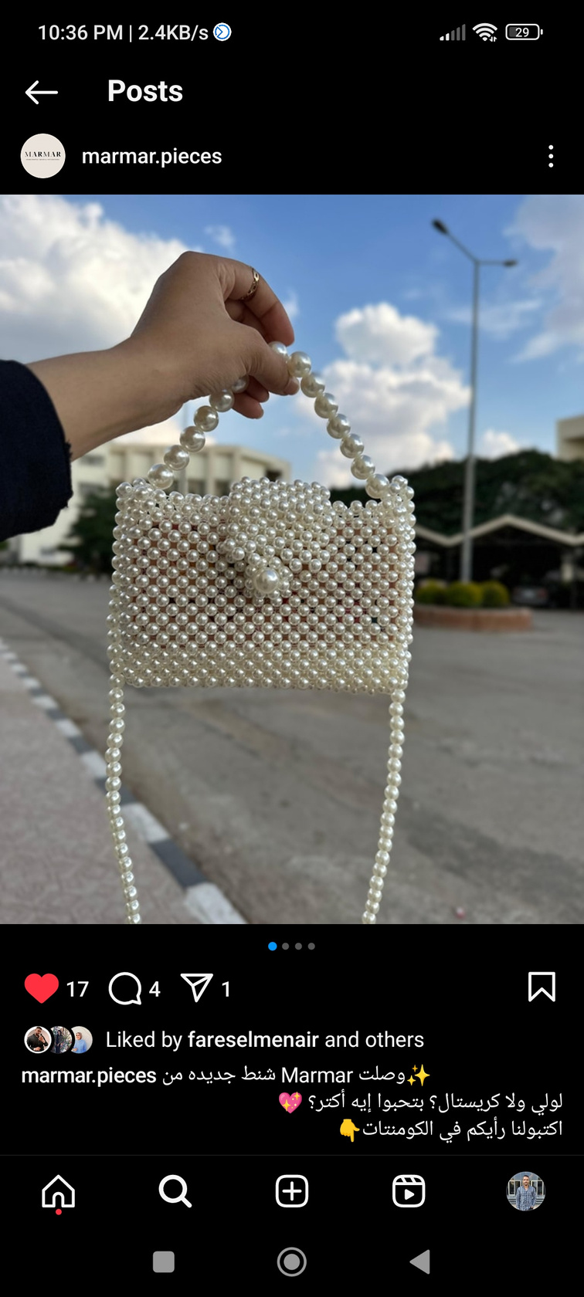
CONTENT

Slide 25
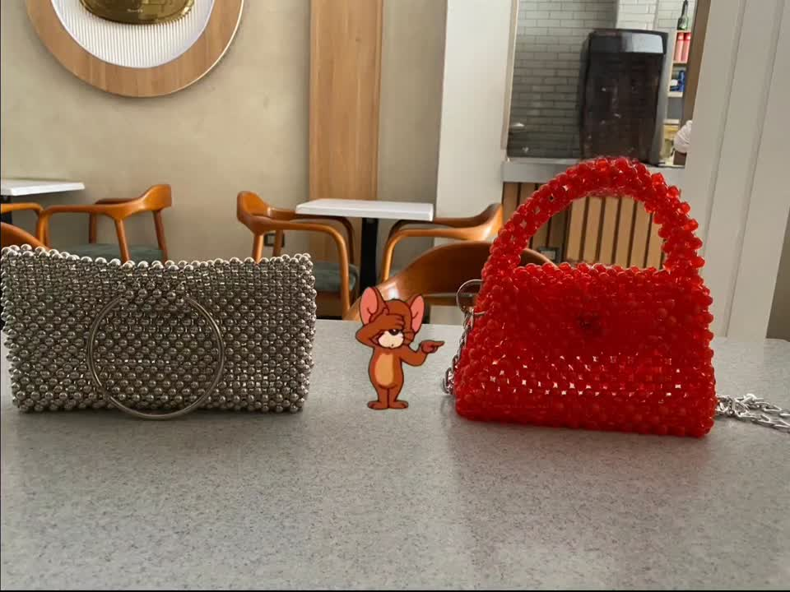
CONTENT

Slide 26

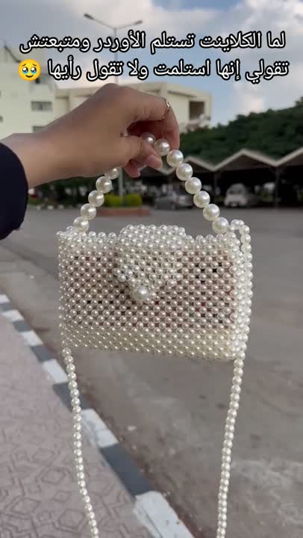
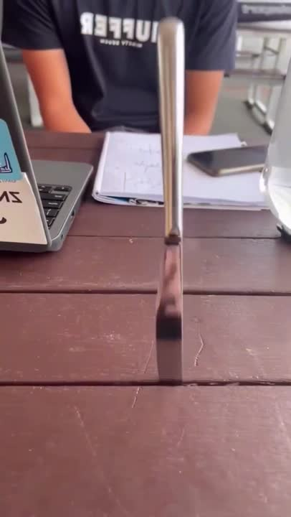
CONTENT

Slide 27
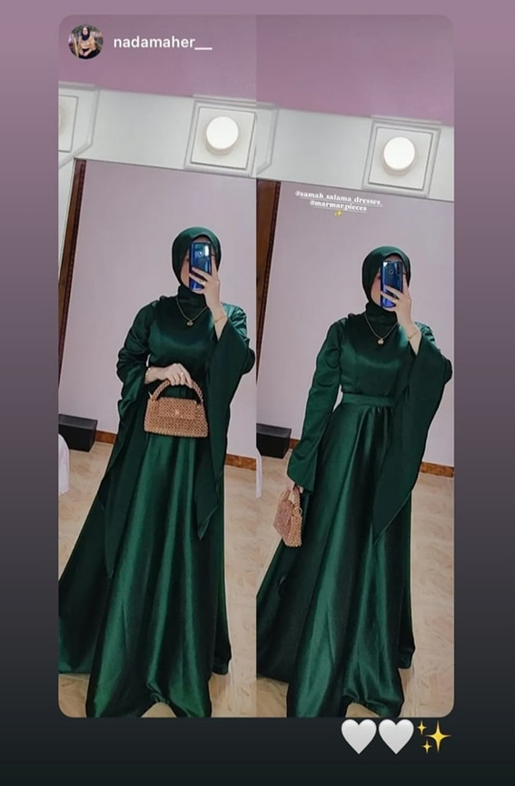
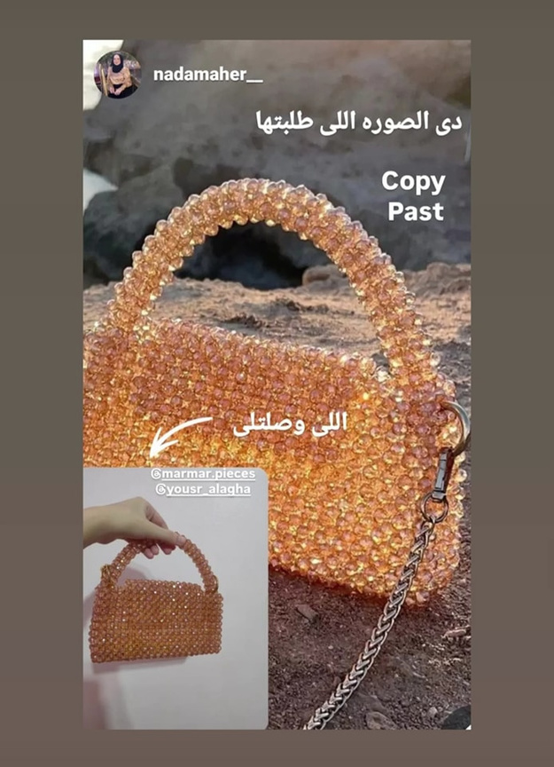
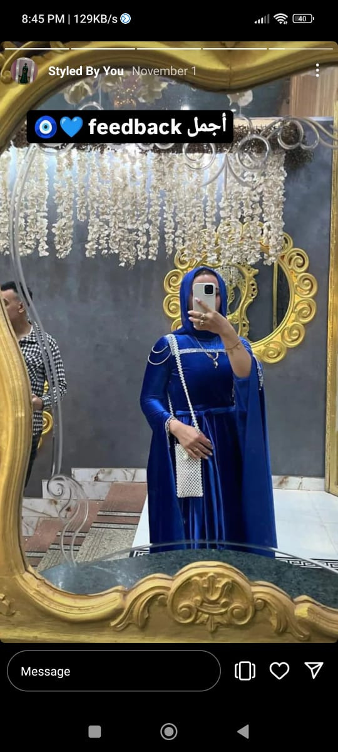
UGC

Slide 28
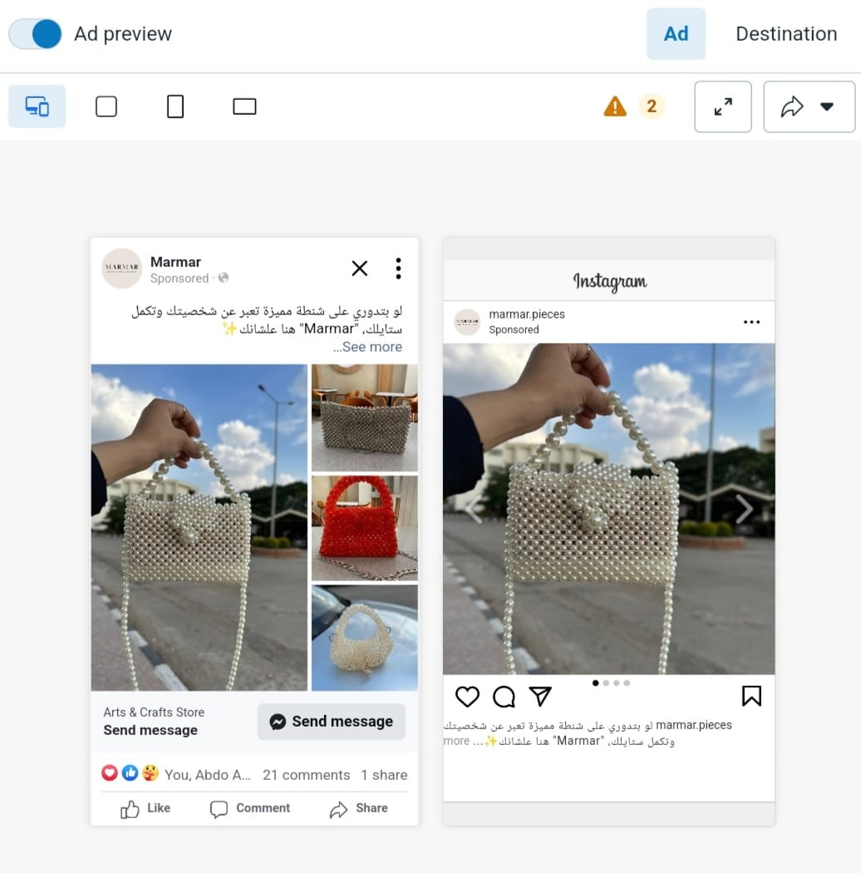
Campaign Management

Slide 29
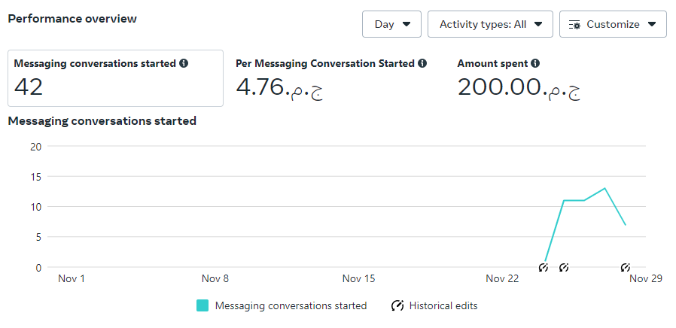
Campaign Insights

Slide 30
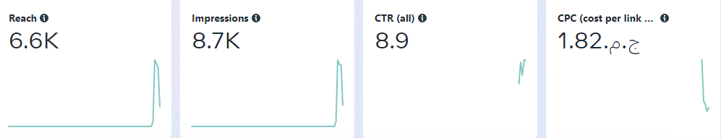
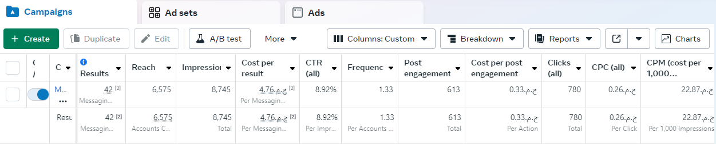
Campaign Analytics

Slide 31
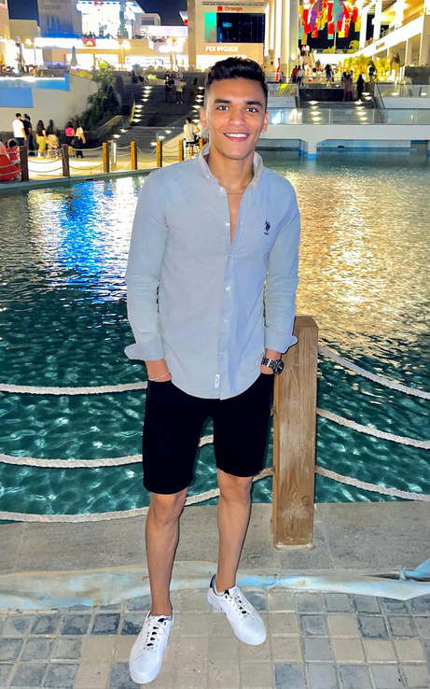
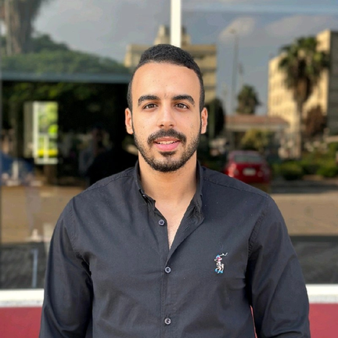
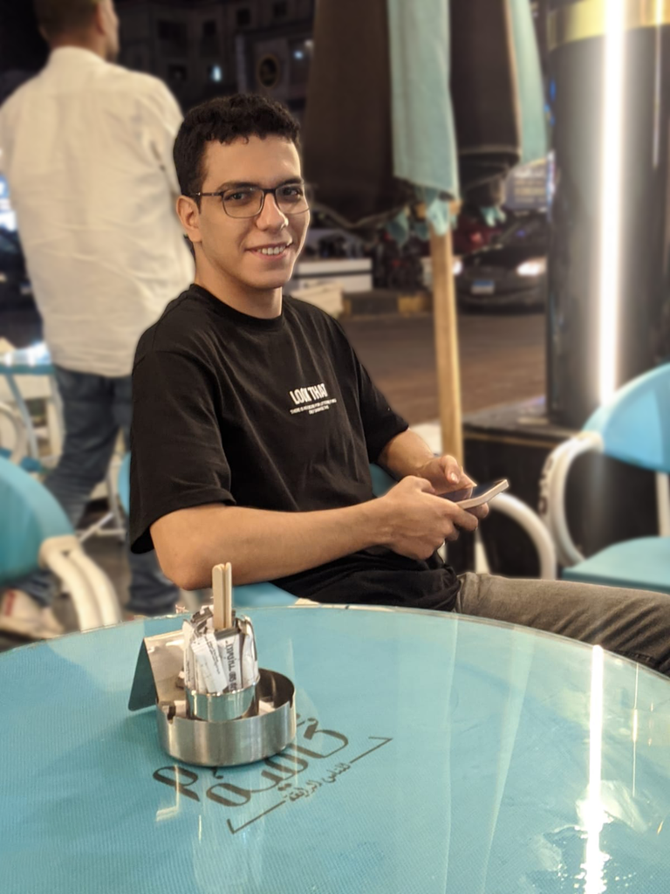
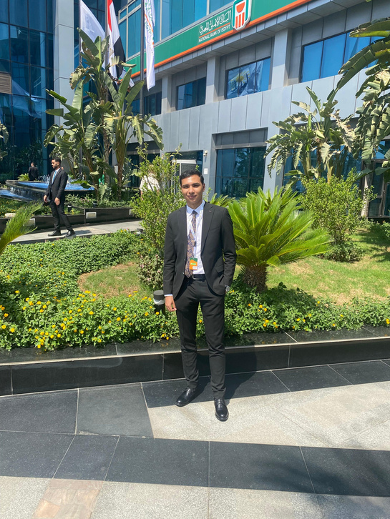
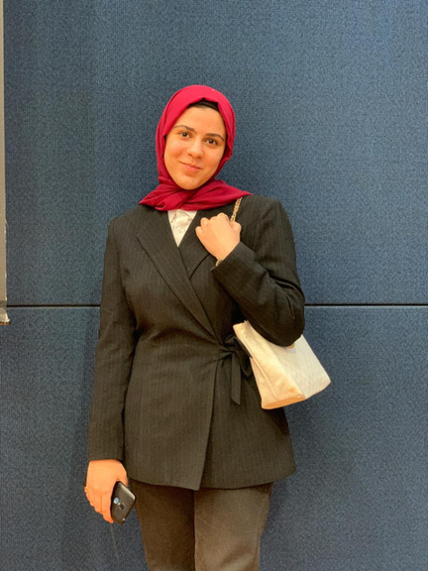
MEET OUR TEAM
Mustafa Etman
Youssef Agwa
Amr Elgendy
Amir Mohamed
Lamia Omar

Slide 32
thank you
for watching

